Slide 1

TRAFFIC SIGNS RECONATION

Slide 2
The purpose of this project was to build a traffic sign recognition application using knowledge acquired from deep neural networks (DNN) and convolutional neural networks (CNN). A CNN model was built, trained and validated, so it can classify traffic sign images using Tensorflow and the GTSDS. Finally, the model was tested on German Traffic signs from the internet.
problem statement:

Slide 3
In this Python project, we’ll create a deep neural network model that can categorize traffic signals in an image into several groups. We can read and understand traffic signs using our model, which is a critical duty for all autonomous vehicles
DESIGN:

Slide 4
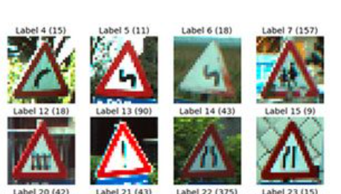
Dataset
Our traffic sign dataset:

Slide 5
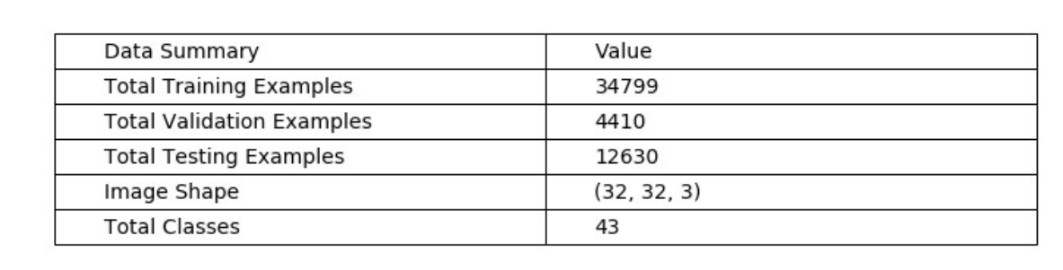
Dataset:
Data Set Summary:

Slide 6
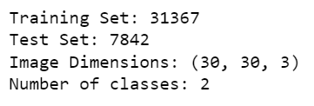
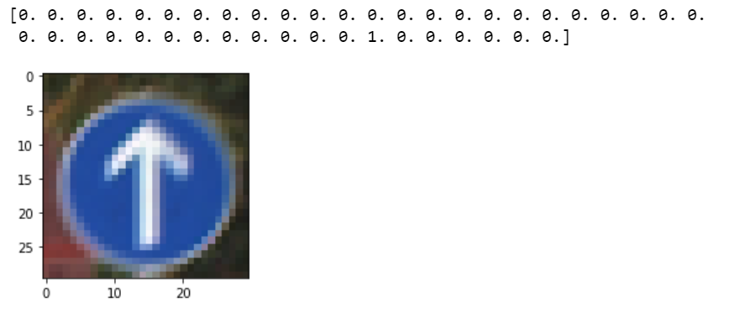
Dataset:
number of images per class
Visualize 1st Image in Training Set

Slide 7
Feature Engineering Converting categorical features into numerical features. Models I used convolutional neural network. Model Evaluation and Selection: we trained the model using model.fit after constructing the model architecture (). We experimented with 32 and 64-batch sizes. When the batch size was set to 64 Our model performed better. And the precision remained constant after 15 epochs.
Algorithm:

Slide 8
1- Numpy and Pandas for data manipulation 2- Scikit-learn for modeling 3- Matplotlib and Seaborn for plotting 4- Keras 5- Tkinter :it is the standard GUI library for Python
Tools:

Slide 9
This project presented a convolutional neural network implementation used for traffic signs classification. The applied methodology has shown significant result with an average validation accuracy of 96% which means that the model has been selected correctly
Result:

